Slide 1
Supporting development of TransCultural Competence for healthcare professionals in the Western Balkans – TCCWB Project number: 101128620
Kick-off meeting
11-12. June. 2024
University of Zenica

Slide 2
Supporting development of TransCultural Competence for healthcare professionals in the Western Balkans – TCCWB Project number: 101128620
History
“Luigj Gurakuqi” University of Shkodra was established on 02. Sept. 1957 as a High Pedagogical Institute. At the beginning this University had 2 Faculties (Faculty of Social Sciences and the Faculty of Natural Sciences).
It changed its status to University of Shkodra, "Luigj Gurakuqi" by the Ministers' Council decree nr. 124, on 28.05.1991. University of Shkodra has now 6 Faculties (Faculty of Social Sciences, Faculty of Educational Sciences, Faculty of Natural Sciences, Faculty of Economics, Faculty of Law and the Faculty of Foreign Languages).

Slide 3
Supporting development of TransCultural Competence for healthcare professionals in the Western Balkans – TCCWB Project number: 101128620
Organisation
Shkodra University is organised as following :
Rector,
Pro – Rectors,
Administrator,
Deans of the Faculties
Heads of the Departments.
The Administrative personnel plays a great role to the progress of the University activity.
Students are organised in “Students Council” which works within the structures of this university

Slide 4
Supporting development of TransCultural Competence for healthcare professionals in the Western Balkans – TCCWB Project number: 101128620
Faculties
University of Shkodra has now 6 Faculties:
Faculty of Social Sciences
Faculty of Educational Sciences
Faculty of Natural Sciences
Faculty of Economics
Faculty of Law
Faculty of Foreign Languages).

Slide 5
Supporting development of TransCultural Competence for healthcare professionals in the Western Balkans – TCCWB Project number: 101128620
The Departments of Paraclinic subjects and Clinic Subjects are included within the Faculty of Natural Sciences at University of Shkodra.
The following 3 Bachelor Study programs and one Professional Master study program are offered
1. Bachelor in General Nursing, 180 ECTS, 3 academic years (started in 2001) and every year there are enrolled 100 students in the first year.
2. Bachelor in Nursing - Midwifery, 180 ECTS, 3 academic years (started in 2007) and every year there are enrolled 80 students in the first year
3. Bachelor in Physiotherapy, 180 ECTS, 3 academic years (started in 2007) and each year there are enrolled 70 students in the first year
4. Professional Master's in "Health Psychology", 60 ECTS, 1 academic year (started in 2012) and every year there are enrolled 70 students in the first year
This Department was part of the CCNURCA project with the main focus in Nursing and is also member of the BIOSINT project consortium with the main focus on Internationalization of the study programs in Nursing

Slide 6
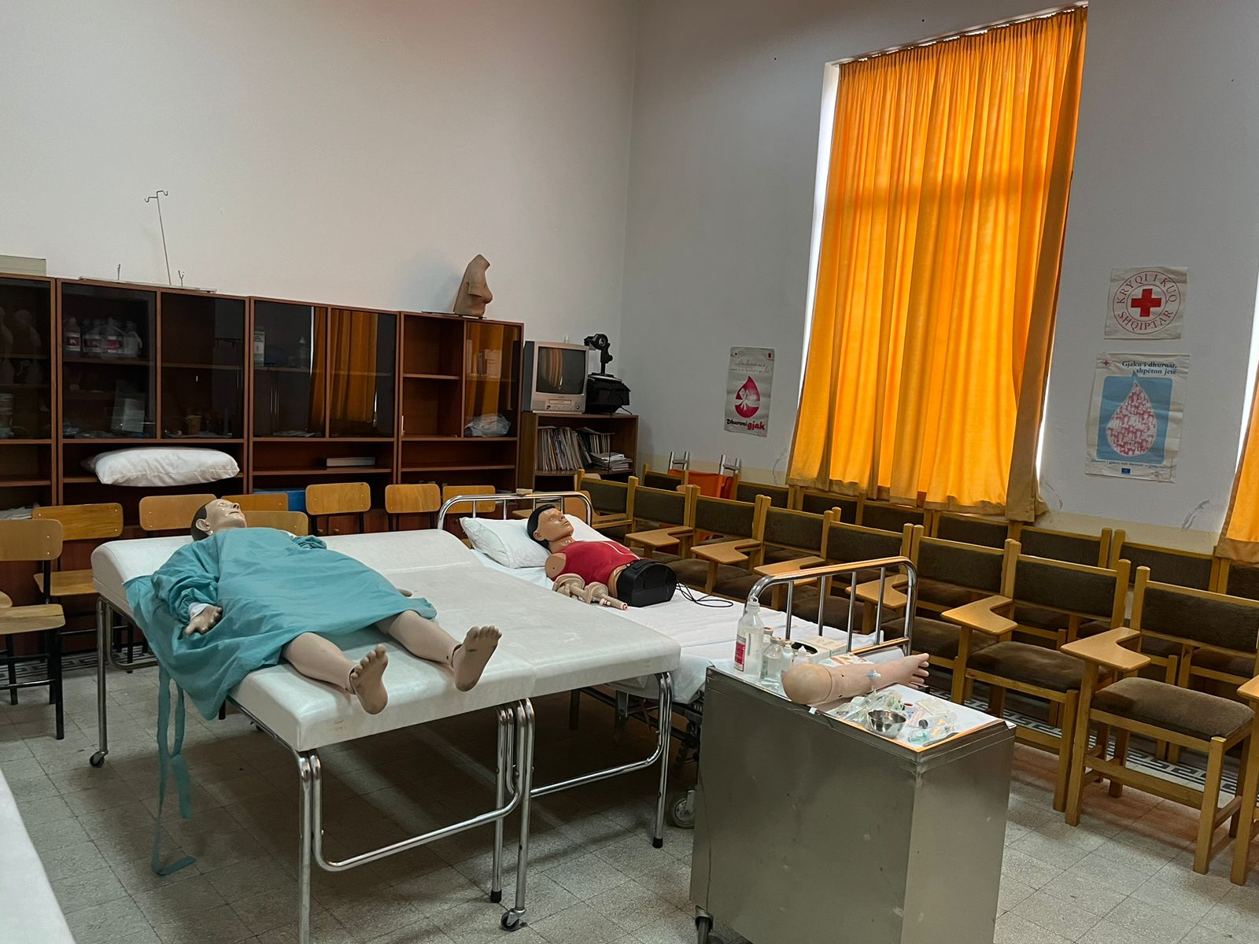
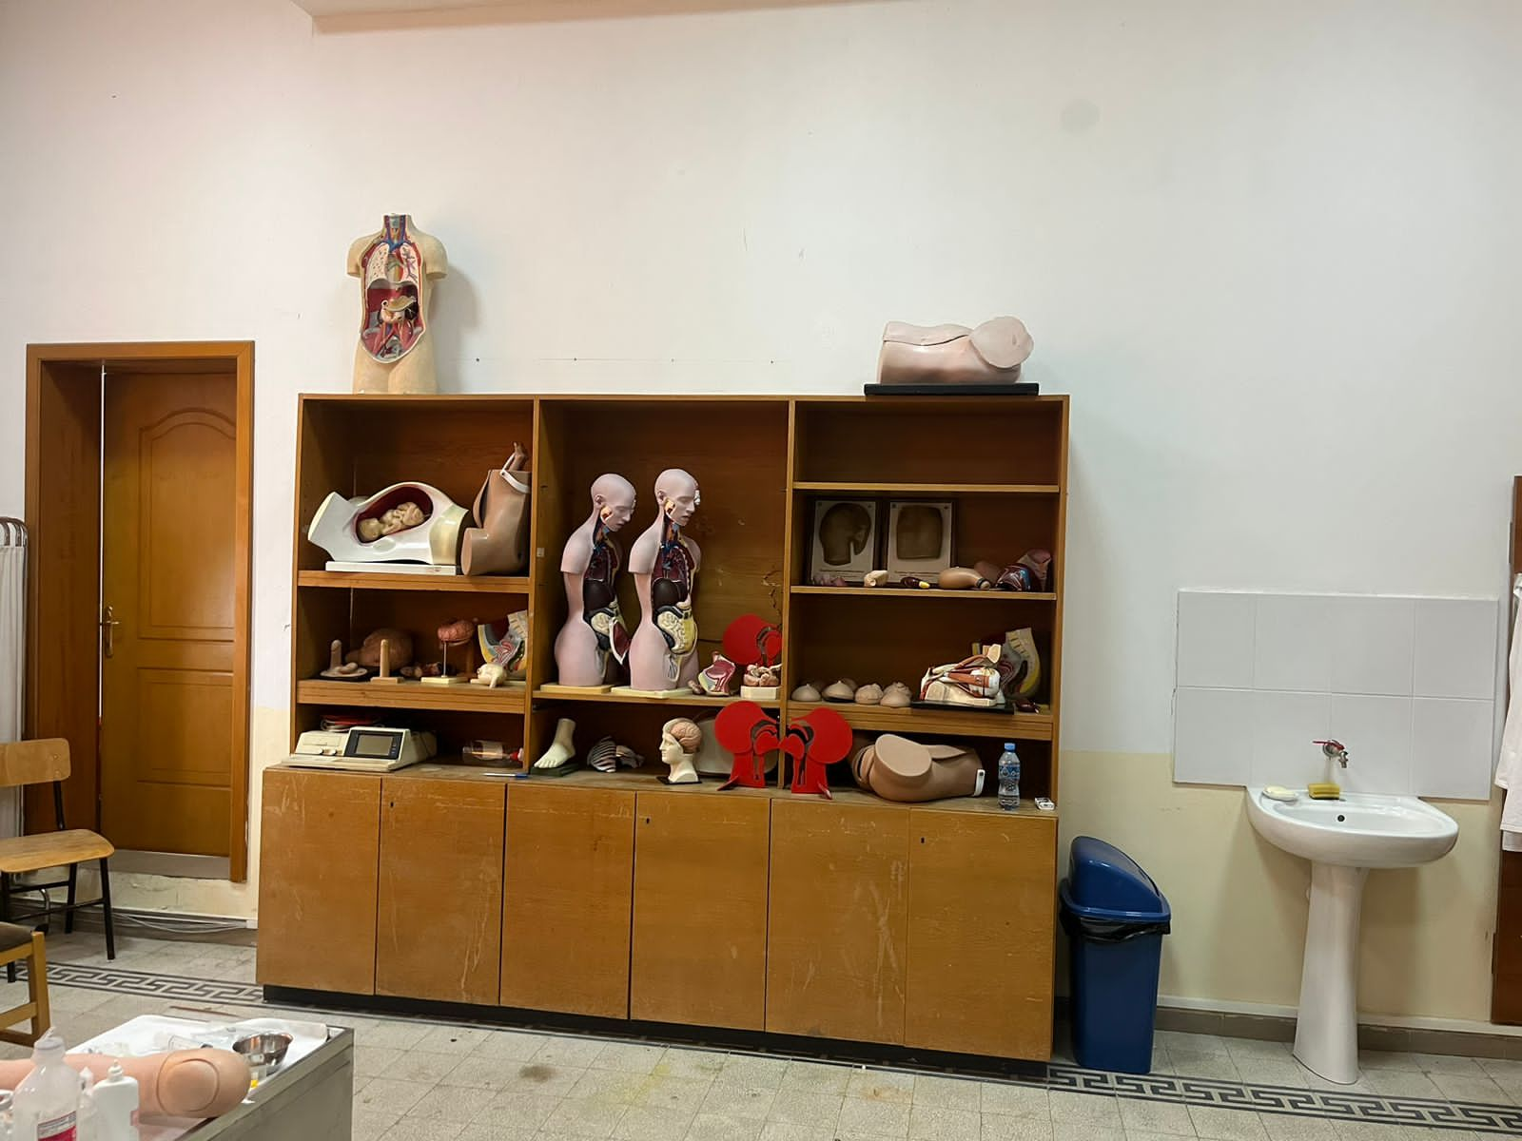
Supporting development of TransCultural Competence for healthcare professionals in the
Western Balkans – TCCWB Project number: 101128620

Slide 7
Supporting development of TransCultural Competence for healthcare professionals in the Western Balkans – TCCWB Project number: 101128620
Work Package 5: Dissemination and Exploitation
Duration M1 – M36
Lead Beneficiary – University of Shkodra “Luigj Gurakuqi”
Main Objective of this Work package:
The project will provide a template for other institutions and educational institutions in partner countries to implement the proposed teaching materials and methodologies. Links with nursing organizations in consortium countries

Slide 8
Supporting development of TransCultural Competence for healthcare professionals in the Western Balkans – TCCWB Project number: 101128620
Task 5.1
Developing promotional materials
Within the project template for ppt presentations, memorandums and official communication will be developed by project consortium. Also document for dissemination strategies will be developed
All participants

Slide 9
Supporting development of TransCultural Competence for healthcare professionals in the Western Balkans – TCCWB Project number: 101128620
Task 5.2
Web page & social media
Project consortium led by WP leader will develop and create web page of project, along with the social media content that will be shared. Every beneficiary will publish project activities and deliverables (where appropriate) on their project webpage. Social media like Facebook, Instagram and LinkedIn will be connected to the partners social media accounts to increase share of information
All participants

Slide 10
Supporting development of TransCultural Competence for healthcare professionals in the Western Balkans – TCCWB Project number: 101128620
Task 5.3
Develop dissemination strategy
The project consortium, will create a dissemination strategy focussed on HEI in BiH and Albania as well as the broader Western Balkans region to facilitate implementation of TCC training materials in non-beneficiary HEIs
UNZE, UES; UNMO, UNSHKO, ECUG, FAMI, SMOC

Slide 11
Supporting development of TransCultural Competence for healthcare professionals in the Western Balkans – TCCWB Project number: 101128620
Task 5.4
Promotional material and Dissemination conference
Two dissemination conferences will be organised one in Bosnia and Herzegovina and one in Albania. These conferences can be combined with other relevant project activities and will be used for promotion of project activities. These conferences will be held before the piloting of the WP3 programmes in order to raise awareness in the region and involve non-beneficiary partners in the co-creation of the materials.
UNSHKO and all participants

Slide 12
Supporting development of TransCultural Competence for healthcare professionals in the Western Balkans – TCCWB Project number: 101128620
Task 5.5
Organization of Final project event
Final event to launch materials and strategy in WP.
All participants

Slide 13
Supporting development of TransCultural Competence for healthcare professionals in the Western Balkans – TCCWB Project number: 101128620
Deadlines
Development of logo, templates, webpage; due date - Month 3
Dissemination and implementation strategy; due date - Month 6
Conferences in WB; due date - Month 32
Closing conference; Due date - Month 36

Slide 14
Supporting development of TransCultural Competence for healthcare professionals in the
Western Balkans – TCCWB Project number: 101128620
Contacts
www.unishk.edu.al e-mail:
julian.kraja@unishk.edu.al
iroshkoder@unishk.edu.al

Slide 15
Supporting development of TransCultural Competence for healthcare professionals in the
Western Balkans – TCCWB Project number: 101128620
Thank you
for
your attention

